Slide 1



UNIVERSITY INSTITUTE OF ENGINEERING
COMPUTER SCIENCE ENGINEERING
Bachelor of Engineering
Robotics Process Automation(20CST-472)
Prepared By: Mrs. Jyoti Chandel(E15580)
Topic : Robotics Process Automation
DISCOVER . LEARN . EMPOWER

Slide 2
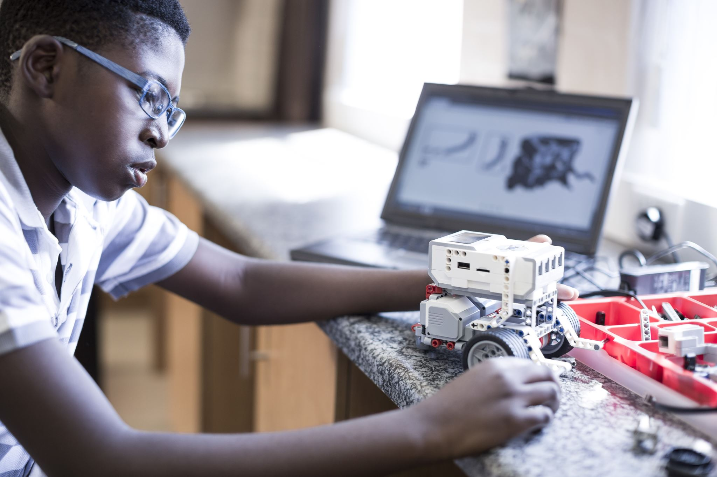
-Overview of RPA
-Definition and concept of RPA
- Evolution of RPA in the business world
-Importance of RPA in modern enterprises

Slide 3
What is Robotics?
Overview of RPA
Evolution of RPA
Why RPA is Used?
Applications of RPA
Advantages and Disadvantages of RPA

Slide 4
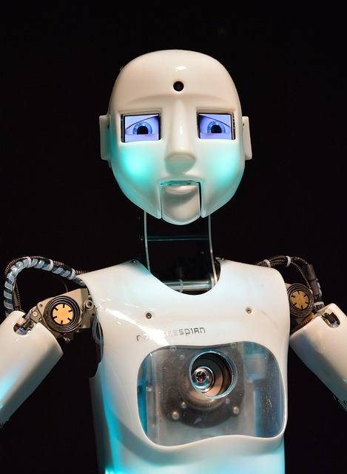
What is Robotics?
Robotics is the combination of
engineering, science and technology
that produces a machine called robot.
Robotics is a domain where people
work with the development and use of
Robots.
• It is mostly used as an alternative
of human beings in various works.

Slide 5
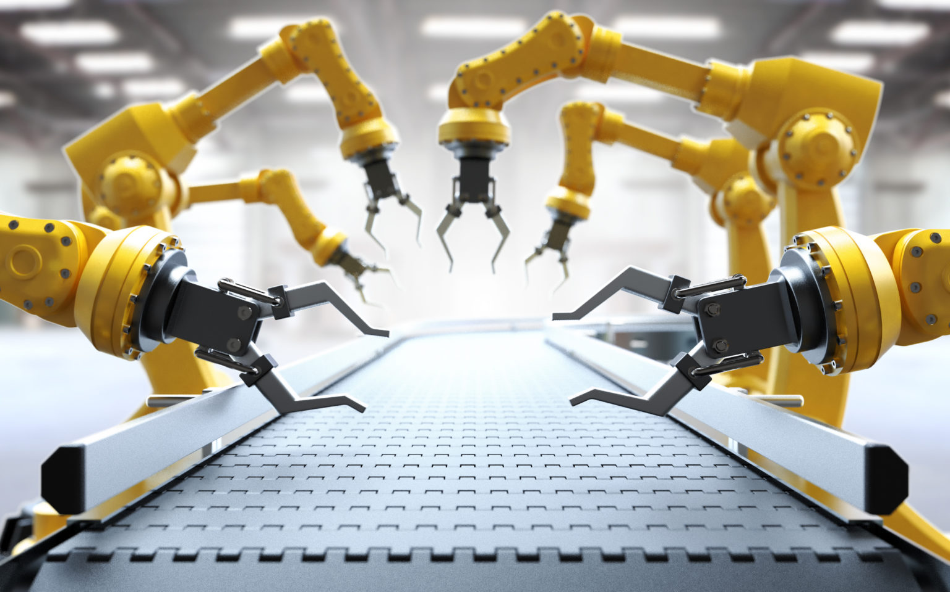
Overview of RPA
Robotic Process Automation is the use of software with Artificial Intelligence (AI) and machine learning (ML) capabilities to handle high-volume, repeatable tasks that previously required humans to perform. Some of these tasks include:
Addressing queries
Making calculations
Maintaining records
Making transactions
This Photo by Unknown Author is licensed under CC BY-SA-NC

Slide 6
What Is Robotic Process Automation (RPA)?
Robotic process automation (RPA) occurs when basic tasks are automated through software or hardware systems that function across a variety of applications, just as human workers do. This can greatly reduce labor costs and increase efficiency by speeding things up and greatly minimizing human error.
The software or robot can be taught a workflow with multiple steps and applications, such as taking received forms, sending a receipt message, checking the form for completeness, filing the form in a folder, and updating a spreadsheet with the name of the form, the date filed, and so on. RPA software is designed to reduce the burden for employees of completing repetitive, simple tasks
Robotic process automation (RPA) is designed to help primarily with office-type functions that often require the ability to do several types of tasks in a specific order. It creates and deploys a software robot with the ability to launch and operate other software. In a sense, the basic concept is similar to traditional manufacturing automation, which focuses on taking one portion of a workflow—or even just one task—and creating a robot to specialize in doing it.

Slide 7
Key Takeaways
Robotic process automation (RPA)
Robotic process automation (RPA) refers to software that can be easily programmed to do basic, repetitive tasks across applications.
RPA creates and deploys a software robot with the ability to launch and operate other software.
Designed primarily for office-type functions, RPA works like a digital assistant, doing routine onerous tasks that would otherwise eat up employees' time.
RPA today is found across a range of industries and applications.
RPA without human oversight, however, can lead to problems, as was the case with mortgage "robo-signers."

Slide 8
Evolution of RPA
Although the term "robotic process automation" can be traced to the early
2000s, it had been developing for a number of years previously.
• RPA evolved from three key technologies: screen scraping, workflow automation and artificial intelligence.
• Screen scraping is the process of collecting screen display data from a legacy application so that the data can be displayed by a more modern user interface

Slide 9
Why RPA is Used?
Companies and business owners these days use the RPA. It is due to the
multiple programs they have to access simultaneously.
• Automating the data correction is one of the benefits of RPA.
• Sales orders and invoice processing are the two areas where the RPA process can shine. Additionally, RPA also increases data consistency levels across the company department systems.
• With any change in the business process, a company would need to hire new employees or train existing employees to map the IT system and business process. Both solutions are time and money-consuming. Also, any succeeding business process change will need hiring or retraining.

Slide 10
Applications of RPA
Some of the top applications of RPA include:
• Customer service: RPA can help companies offer better customer service by automating contact center tasks, including verifying e-signatures, uploading scanned documents and verifying information for automatic approvals or rejections.
• Accounting: Organizations can use RPA for general accounting, operational accounting, transactional reporting and budgeting.
• Financial services: Companies in the financial services industry can use RPA for foreign exchange payments, automating account openings and closings, managing audit requests and processing insurance claims.

Slide 11
Applications of RPA
Healthcare: Medical organizations can use RPA for handling patient records, claims, customer support, account management, billing, reporting and analytics.
Human resources: RPA can automate HR tasks, including onboarding and offboarding, updating employee information and timesheet submission processes.
Supply chain management: RPA can be used for procurement, automating order processing and payments, monitoring inventory levels and tracking shipments.

Slide 12
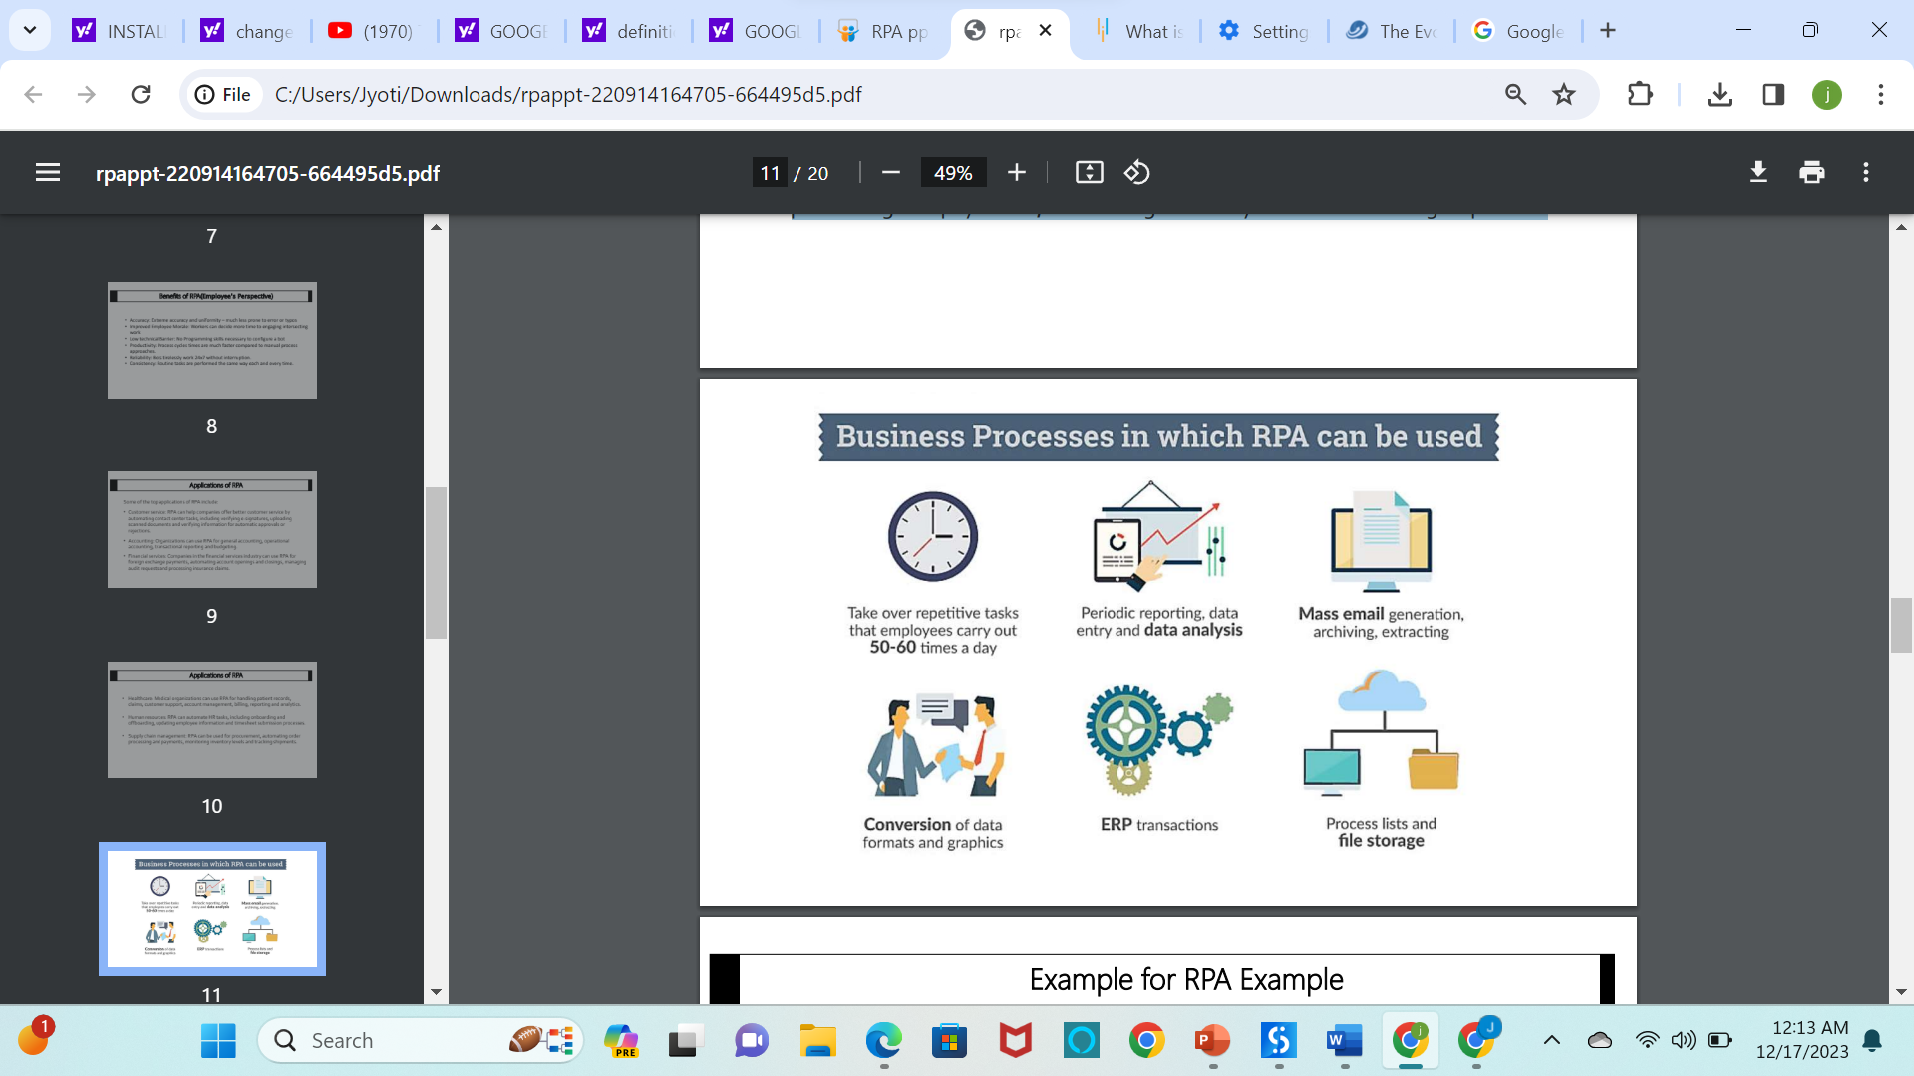

Slide 13
Advantages and Disadvantages of RPA
Pros
• Cost Efficient Installation Cost
• Hands-free convenience
• Save Time with Automated Tasks
• Manage Multiple Devices
• Less errors compare to humans
• Notifications in case of trouble
• Reduces Workload
Cons
Installation Cost
• Complexity
• Setup and Configuration
• More Technical Security Threats
• Increases unemployment
• Privacy Concerns
• Maintenance & Repair Issues

Slide 14
THANK YOU

